Slide 1
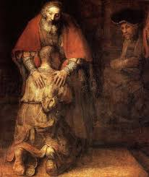
First Holy Communion Meeting 2: Reconciliation

Slide 2
Opening Reflection
A reading from the Holy Gospel according to Saint Luke.
(Luke 15: 4- 7 – adapted)
One day, Jesus told this story:
“If one of you had one hundred sheep and one of them gets lost, wouldn’t you leave the other ninety nine in the meadows and go looking for the one that is lost until you have found it?”
Once the lost sheep has been found, the shepherd will put it on his shoulders and carry it home with joy. When he gets home, the shepherd will say to his friends and neighbours, “Rejoice with me because my sheep which was lost has been found again.”
And so I tell you, there will be greater joy in heaven for one person who strays away, and later has a change of heart and comes back, than for those people who think they have no need to change.
The Gospel of the Lord.

Slide 3
Agenda
preparation in school
Sacrament of Reconciliation/discussion
Penitential Service
Monday 11t^{h} March 2024 @ 5.30pm, in church
First Holy Communion
Saturday 11th May 11.00am
Photographs, on the day, after the service
questions
closing prayer

Slide 4
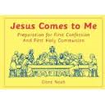
Preparation in School
Jesus comes to me…
Chapter 6: Jesus saves and heals us
Chapter 7: Jesus loves us all
Chapter 8: getting ready for your confession
Chapter 9: making your First Confession

Slide 5
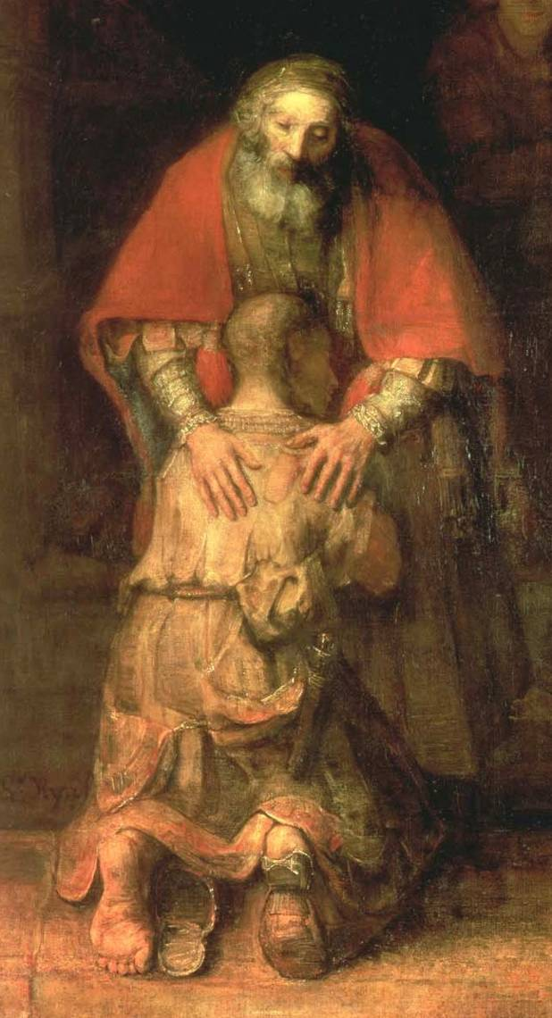
What is Confession?
KEY DEFINITION
Confession (or Penance or Reconciliation) is the sacrament where we confess our sins, we are sorry for our sins, and we are absolved of sin through the ministry of a priest.

Slide 6
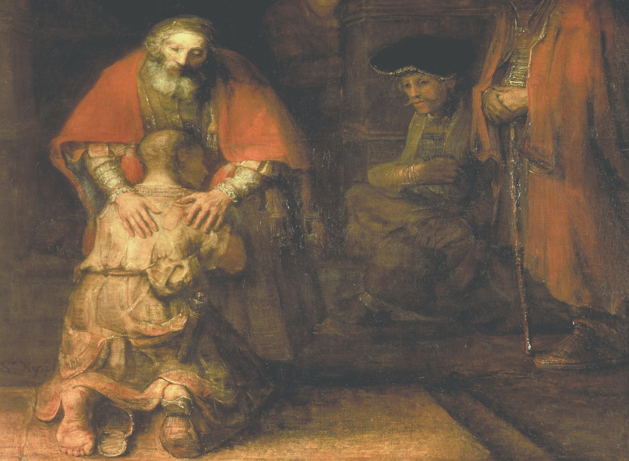
The moment of reconciliation between the father and son in the parable of the prodigal son. This reminds us of the mercy of God.
The father
who embraces and welcomes his son home with joy.
The son
who confesses his sin and asks forgiveness.
Rags and sandals
symbolising the terrible condition to which sin has brought the son and also his sorrowful state.

Slide 7
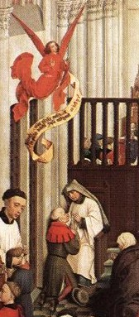
Why is Confession important?
Confession is important because it is the normal way we can be forgiven serious sin after Baptism.
Regular Confession is important because it helps us to deal with our sins quickly. It also gives us grace to resist temptation.
The act of confessing gives us healing and a sense of release from the burden of sin.
‘Confession’
from
The Seven Sacraments
by Weyden

Slide 8
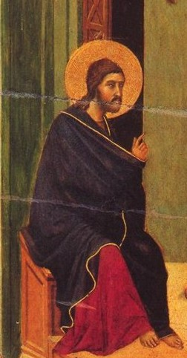
How did Christ establish Confession?
The Bible tells us that… only God can forgive sins (Mk 2:7). However, Jesus Christ gave his power to forgive sins to his apostles.
As the priest is one of Jesus’ apostles, he has the power to forgive us of our sins.
He breathed on his apostles, and said to them,
“Receive the Holy Spirit. If you forgive the sins of any, they are forgiven; if you retain the sins of any, they are retained.”
Jn 20:22-23
‘Christ Teaches his Disciples’
by Duccio di Buoninsegna

Slide 9
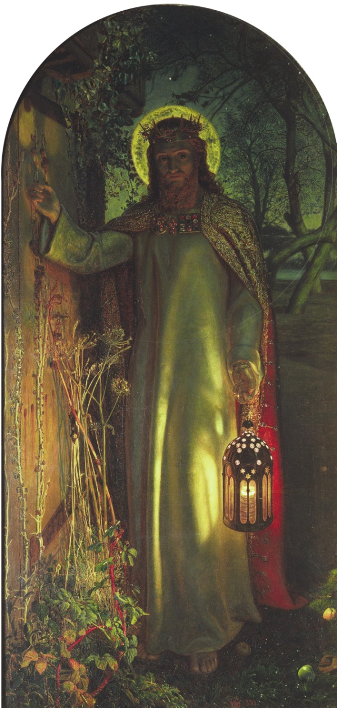
What is necessary for Confession?
Our actions
Contrition. Being sorry for our sins and wanting to avoid making the same mistakes in future.
Verbal confession of sins: telling the kinds of sins we have committed and the number of times we have committed them. We must include all my sins.
Wanting to repair the damage caused by sin: we can do this by our actions- proving we are sorry, and by doing the penance set by the priest.

Slide 10
What is necessary for Confession?
THE WORDS OF THE PRIEST…
After hearing our confession of sins, giving us a penance and hearing our act of contrition, the priest gives us absolution (forgiveness): God, the Father of mercies, through the death and resurrection of his Son has reconciled the world to himself and sent the Holy Spirit among us for the forgiveness of sins; through the ministry of the Church may God grant you pardon and peace, and I absolve you from your sins in the name of the Father, and of the Son, and of the Holy Spirit. Amen

Slide 11
Discussion questions…
Select one or more of the following:
Discuss why God has given us the gift of the sacrament of Confession.
Discuss why being sorry, confession of sins and trying to repair the damage of sin are all important parts of receiving the sacrament.

Slide 12
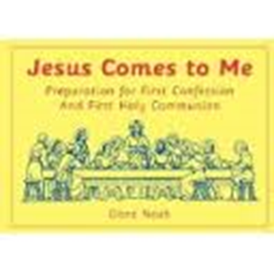
Penitential Service
This year we will be having a Penitential service, where all of the children will make their First Confession on the same evening.
During the service the children will be invited one at a time to one side of the altar to make their First Confession; a visiting Priest will be helping Father John during this service.
The pages in the ‘Jesus comes to me’ booklet will be really helpful in preparing your children for the sacrament, especially the section on the ‘examination of conscience’.
Miss Gilbert, Father John and myself will also help to prepare the children for this service.

Slide 13
Concluding prayer…
Loving God, look upon these children who were brought to you in Baptism. They are continuing their journey as they prepare to receive your peace through the Sacraments of Reconciliation and Holy Communion. On their journey, they are discovering more and more how much you love them. But they, like all of us, find it hard sometimes to love you as you love them.
They know that Jesus, your son, teaches them to love one another, and that he died on the cross because he loves us all so much. As they prepare to receive the Sacrament of Reconciliation, they want to give their hearts to Jesus and live as he asks.
Help them to live out your word and give them the peace that comes from you. Give them the strength they need to follow Jesus and to live in peace with their sisters and brothers. We ask this through Jesus Christ, Our Lord.
Amen.

Slide 14
Thank you for your time and for your commitment to your child’s spiritual development

